Slide 1
Java Methods

Slide 2
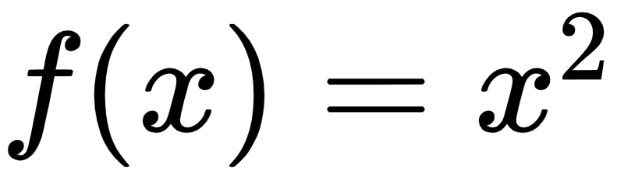
What is a method?-Intro
This is a function that returns the squared value of “x”.
x | f(x)
2 | f(2) ⇒ 4
3 | f(3) ⇒ 9
Additional Info:
Methods define the behavior of a class
In programming, function = block of code that does a task.
Method is a jargon used for function.

Slide 3
Types of Java Methods
Standard Library Methods
&
User Defined Methods

Slide 4
Standard Library Methods
Standard Library methods are built-in methods in Java that are readily available for use.
For example,
print() is a method of java.io.printstream. And print(“”) prints things inside the quotation marks.
sqrt() is a method of Math class and returns the square root of a number.

Slide 5
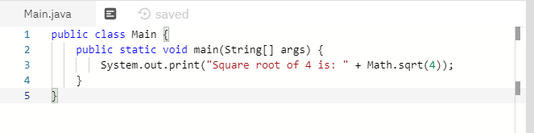
Standard Library Methods-example
Type

Slide 6
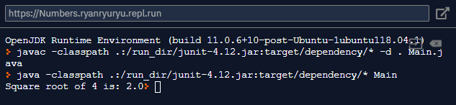
Standard Library Methods-example
Result:

Slide 7
User-defined Methods
You can also define methods inside a class. Such methods are called user-defined methods.
Any Questions so far?

Slide 8
User-Defined Methods: How do I create them?
Before you can call a method, you need to define them.
public static void myMethod() {
System.out.println(“My Function called”);
}
As you can see, here, a User-defined method called myMethod() is called.
And before you can declare the function name, there should be public, static, and void.
modifier static returnType nameOfMethod (Parameter List) {
// method body
}
In the above program, our method doesn’t accept any arguments. Hence the empty parenthesis (). You will learn about passing arguments to a method later in this lesson.
Complete syntax of UDM
Notes:
Explin: Modifer, static, returntype, nameofmethod.

Slide 9
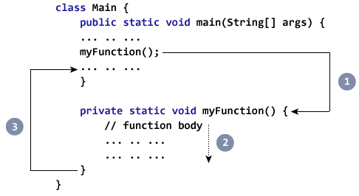
How do you call Java method?
myMethod(); It’s so simple.

Slide 10
How do you call Java method?
I’ll give you 10~15 min.
class Main {
public static void main(String[] args) {
System.out.println("About to encounter a method.");
// method call
myMethod();
System.out.println("Method was executed successfully!");
}
// method definition
private static void myMethod(){
System.out.println("Printing from inside myMethod()!");
}
}
TYPE:
What was the result?

Slide 11
How do you call Java method?
This is the result:
About to encounter a method.
Printing from inside myMethod().
Method was executed successfully!
Notes:
THEN EXPLAIN!!!!!!
SO LIKE, WHY the METHOD mymethod() in the above doesn’t accept any arguments also there is no return value!!!

Slide 12
How do you call Java method?: Example 2
I’ll give you 10~15 min.
class Main {
public static void main(String[] args) {
Output obj = new Output();
System.out.println("About to encounter a method.");
// calling myMethod() of Output class
obj.myMethod();
System.out.println("Method was executed successfully!");
}
}
class Output {
// public: this method can be called from outside the class
public void myMethod() {
System.out.println("Printing from inside myMethod().");
}
}
TYPE:
What was the result?

Slide 13
How do you call Java method?
About to encounter a method.
Printing from inside myMethod().
Method was executed successfully!
This is the result:
Notes:
THEN EXPLAIN!

Slide 14
How do you call Java method?
class SquareMain {
public static void main(String[] args) {
int result;
result = square();
System.out.println("Squared value of 10 is: " + result);
}
public static int square() {
// return statement
return 10 * 10;
}
}
Notes:
THEN EXPLAIN!

Slide 15
Java Methods with Arguments and Return Values
A Java method can have zero or more parameters. And, they may return a value.
Notes:
THEN EXPLAIN!

Slide 16
Java Methods with Arguments and Return Values- examples
Notes:
THEN EXPLAIN!

